Slide 1
One point Grid Method

Slide 2
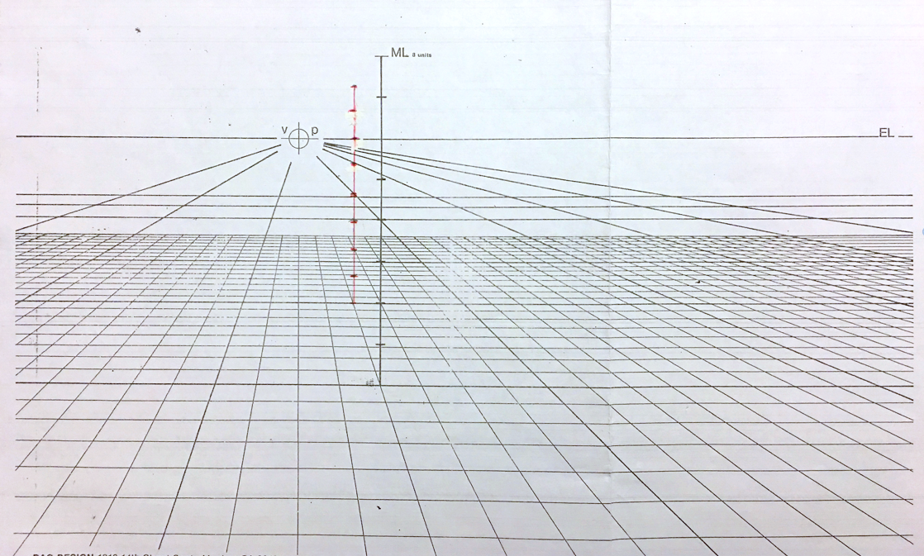
Back wall 17’ – 6” by 8’H
THL
A

Slide 3
A

Slide 4
Depth of room 11’- 6”
A
B

Slide 5
A
B

Slide 6
Draw the 1’ dropped ceiling
A
B

Slide 7
Draw the 1’ dropped ceiling
A
B

Slide 8
Draw the 1’ dropped ceiling
A
B

Slide 9
Draw the 1’ dropped ceiling
A
B

Slide 10
Draw the 1’ dropped ceiling
A
B

Slide 11
Draw 6’ wide sliding doors – 9’ from corner A (measure from plan)
A
B

Slide 12
Draw Ref. 3’w x 2’-3”d x 5’-6’h
A
3’
2’-3”
B

Slide 13
Draw Ref. 3’w x 2’-3”d x 5’-6’h
5’-6”
A
B

Slide 14
Draw Ref. 3’w x 2’-3”d x 5’-6’h
A
B

Slide 15
Draw Ref. 3’w x 2’-3”d x 5’-6’h
A
B

Slide 16
Draw Ref. 3’w x 2’-3”d x 5’-6’h
A
B

Slide 17
Draw Ref. 3’w x 2’-3”d x 5’-6’h
A
B

Slide 18
Draw Ref. 3’w x 2’-3”d x 5’-6’h
A
B

Slide 19
Draw Ref. 3’w x 2’-3”d x 5’-6’h
A
B

Slide 20
Draw Oven wall – line up with dropped ceiling
A
B

Slide 21
Draw Oven wall
A
B

Slide 22
Draw Oven wall
A
B

Slide 23
Draw Oven wall
A
B

Slide 24
Draw Oven wall
A
B

Slide 25
Draw Oven wall
A
B

Slide 26
Draw Oven wall
A
B

Slide 27
Draw island – line up with oven wall
A
B

Slide 28
Draw island
3’
A
B

Slide 29
Draw island
3’
A
B

Slide 30
Draw island
3’
A
B

Slide 31
Draw island
A
B

Slide 32
Draw island
A
B

Slide 33
Draw island
A
B

Slide 34
Draw island
A
B

Slide 35
Draw island
A
B

Slide 36
