Slide 1
Tiny House Study
Katie Davis

Slide 2
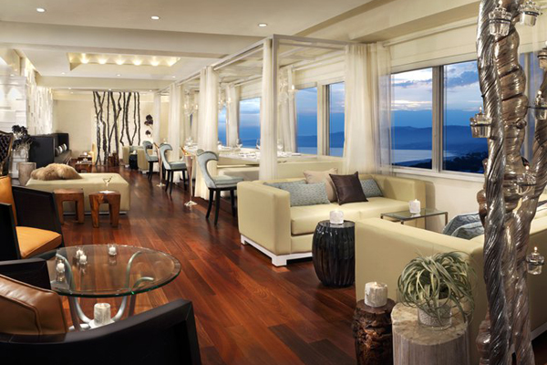
Urban Chic
Sophisticated
Sleek
Tasteful
Elegance
Stylish
Smart
Edgy

Slide 3
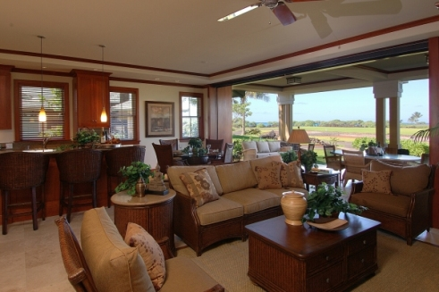
Multipurpose Use Space
Combine rooms allowing openness and freedom to roam between each other
Circulation patterns that don’t cut through spaces, but allow places to be uninterrupted

Slide 4
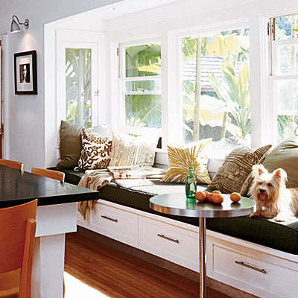
Architectural Elements
No walls to break down space
Many windows
Window seating
Add attention to outside opening up the space
Allow seating to connect rooms

Slide 5
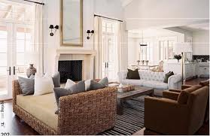
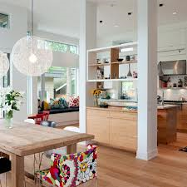
Non-architectural Elements
Use furniture that does not close off a particular space
Benches
Open countertops
Allow the flow from room to room

Slide 6
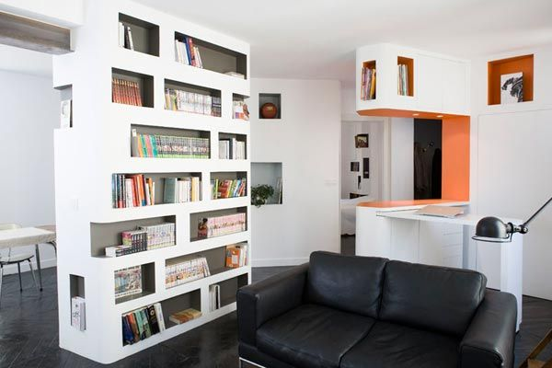
Other Elements
Soft Finishes
Not much space and sometimes residents may be close to the walls
Niches and bays
allow for privacy without being completely closed off

Slide 7
Spaces & Functions
Main Room
Where most of the down time is spent, and everyone comes together
Kitchenette
Serves purpose of a kitchen, but on smaller scale with less work space
Eating area
Can sit down to eat
Seating area
Provides seating but not for long periods of lounging around
Bathroom
Facility for private grooming
Closet area
For storage and putting items not wanted laying around
If no foyer, this can be functional in an entrance way
Bedroom
Resting at night or a personal place to get away

