Slide 1
Precendent study
Brooke Mays
Notes:
Navy and Orange

Slide 2
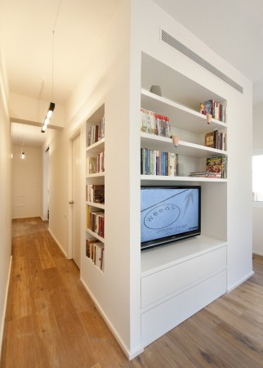
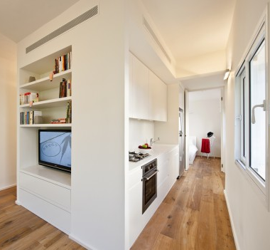
Tele-viv, Israel
~ 430 sq ft.
Cube in the center of the space allows for a great flow in the space as well as making the space seems larger. The light colors and clean appearance make it look larger as well.
Notes:
http://www.archdaily.com/183169/40-sqm-refurbishment-sfaro/

Slide 3
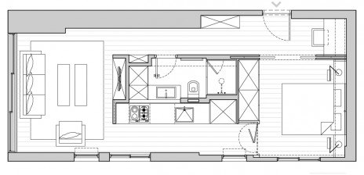
Floor plan
The space is open; yet it is separated into different areas for whatever occasion is called for.

Slide 4
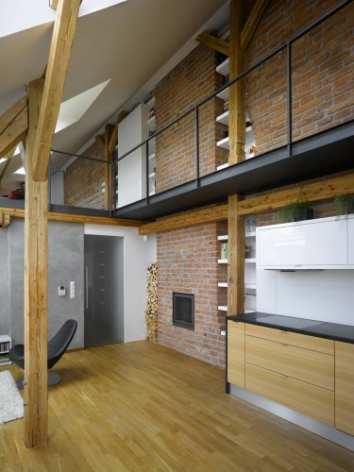
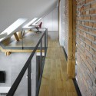
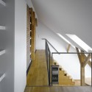
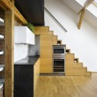
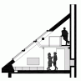
Prague
This space was creatively designed around a slanted roof that extended all the way to the floor. The loft is used as storage space in the upper area. Underneath of the stairs and in every spare area of the space is used for storage.
Notes:
http://www.archdaily.com/222272/mini-loft-apartment-in-prague-dalibor-hlavacek/

Slide 5
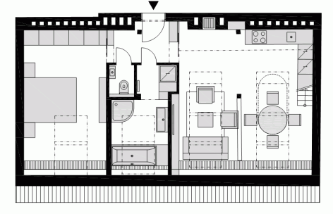
Floor Plan
The space is separated into distinct areas and placed so that the slanted areas are used for seating and the higher ceilings are for areas where the participants will be standing for much of the time.

Slide 6
USES OF SPACE
KITCHEN
BATHROOM
MAKING AND STORING FOOD AND NECESSARY EQUIPMENT FOR COOKING/BAKING
BATHING/SHOWERING,
PERSONAL CARE
STORAGE OF PERSONAL PRODUCTS, LINENS

Slide 7
SPACE GOALS
STORAGE
BEDROOM
BATHROOM
KITCHEN
LIVING AREA
DINING AREA
CLOSET
PROVIDE AMPLE AMOUNTS OF STORAGE IN ALL POSSIBLE PLACES
KEEP THE CEILINGS HIGH BUT ADD STORAGE IN LOFT AREA
USE SOFT, NEUTRAL COLORS AND NATURAL MATERIALS
MAXIMIZE VIEWS AND LIGHT TO MAKE SPACE LOOK LARGER

Slide 8
USES OF SPACE…
LIVING AREA
DINING AREA
RELAXING
ENTERTAINMENT
STORAGE OF ENTERTAINMENT NEEDS (TV, DVDS, MAGAZINES, BOOKS)
EATTING

Slide 9
USES OF SPACE…
BEDROOM
CLOSET
SLEEPING, RELAXING
STORAGE OF CLOTHING
OTHER STORAGE

