Slide 1
Tiny House
Margaret Burke

Slide 2
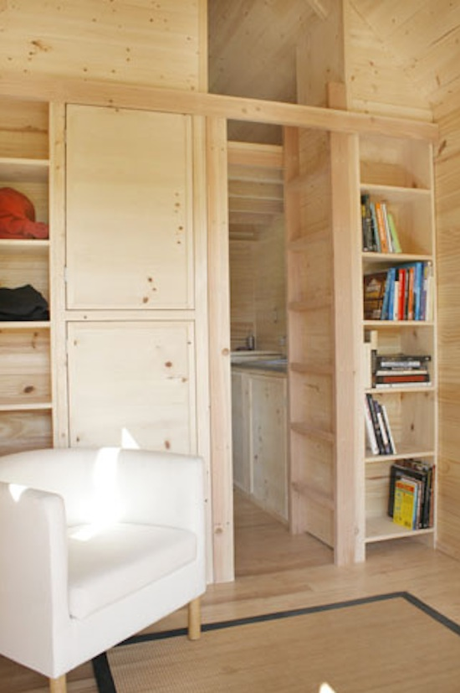
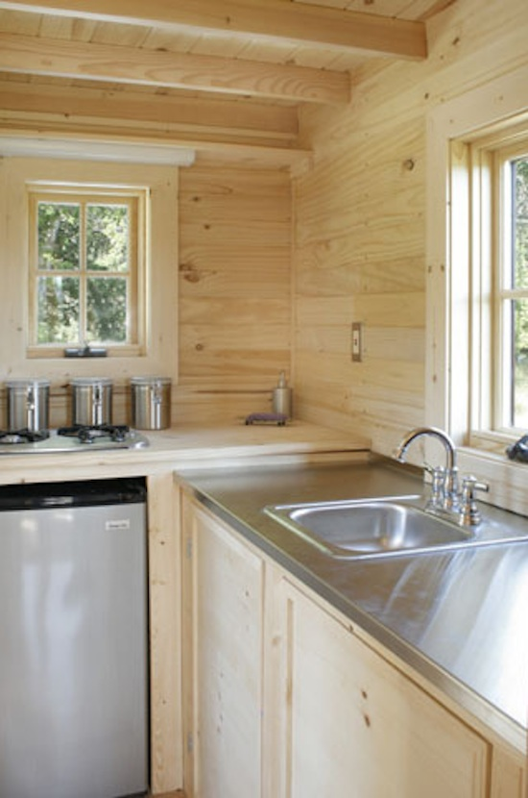
-Use of light colors and natural lighting
-Clean and simple to avoid cluttered/cramped look
-If walls are needed, create shelving, multipurpose uses

Slide 3
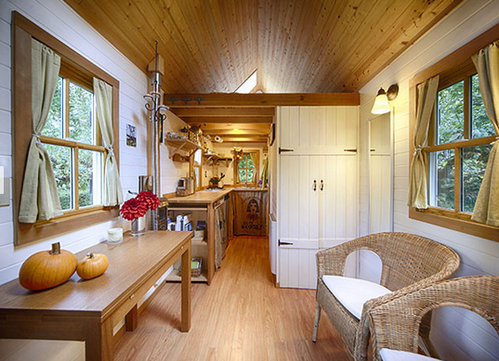
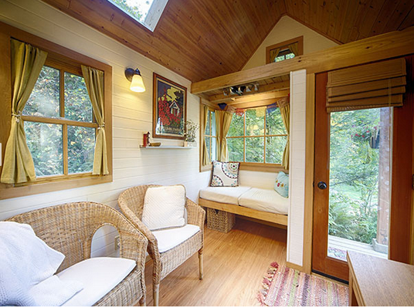

Slide 4
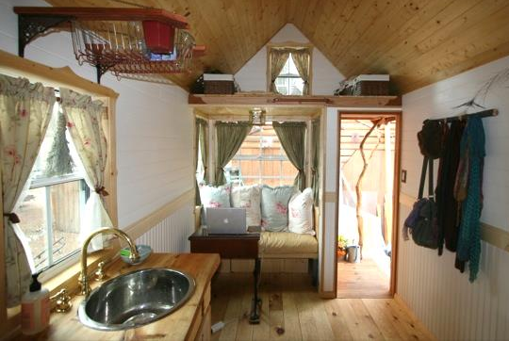
-seating area → use a drop down table to create an eating area
-Be sure to add wheels or felt to the legs of
furniture for mobility

Slide 5
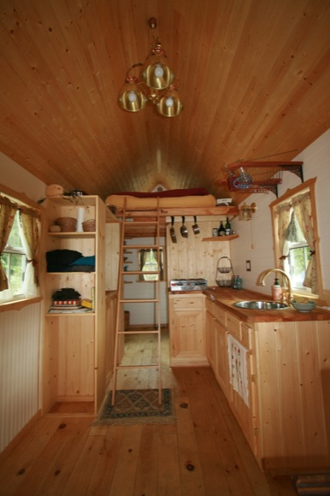
-Open space planning
-No completely enclosed spaces within the house
creates a bigger feel

Slide 6
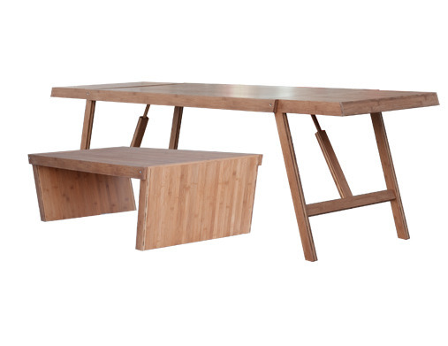
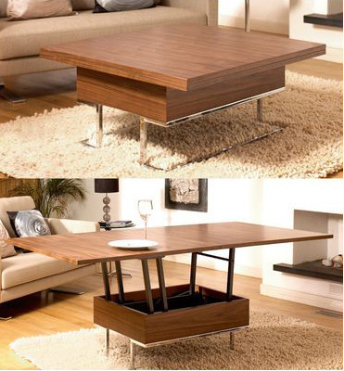
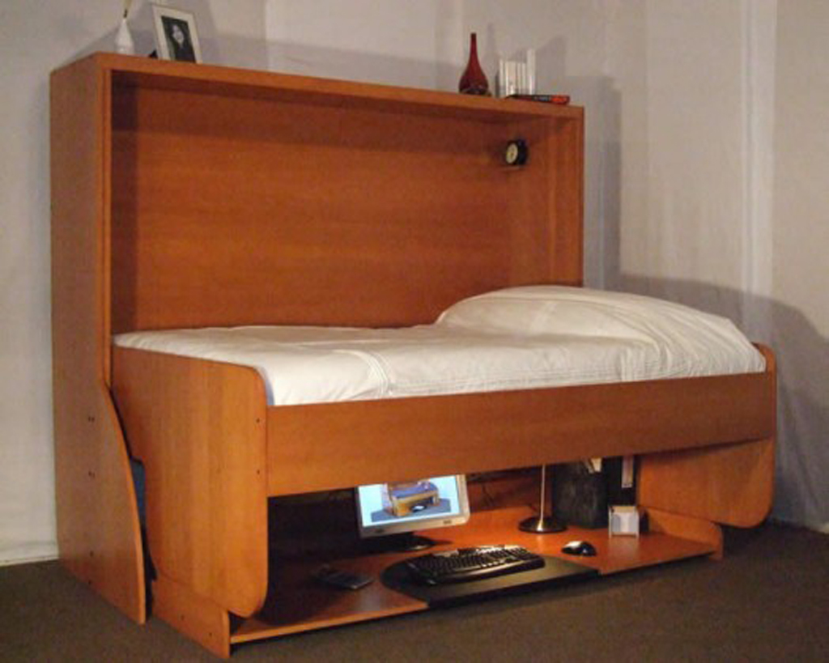
-Using multipurpose furniture is a non-architectural way of creating versatility

Slide 7
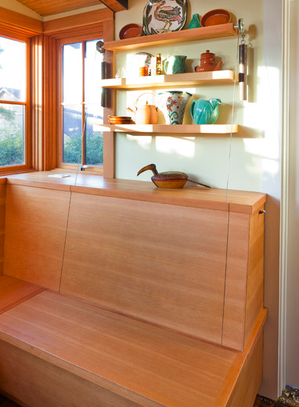
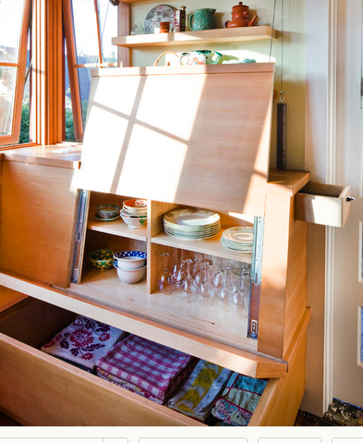
→

Slide 8
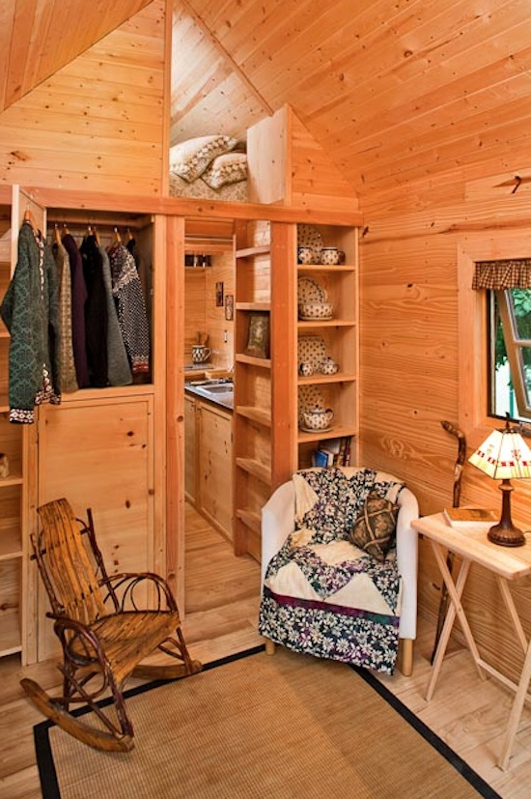
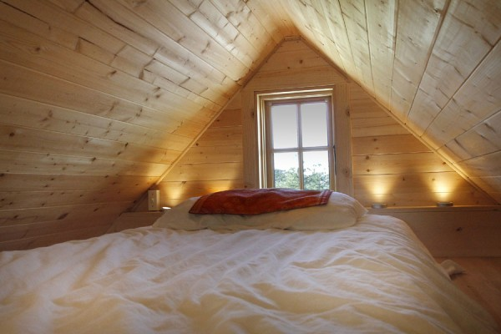
Loft Ideas

Slide 9
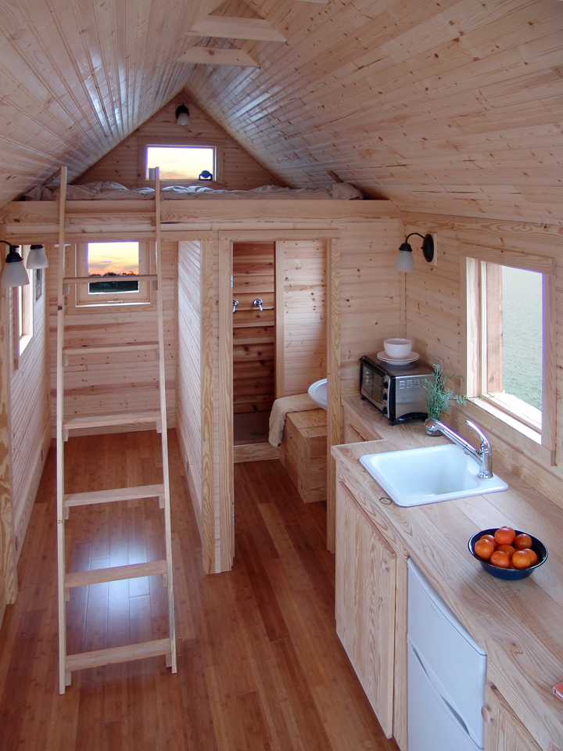
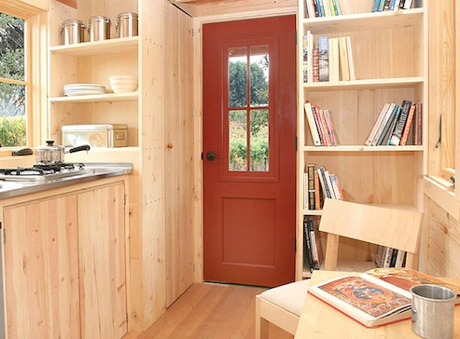
-Place closet in small awkward spaces

Slide 10
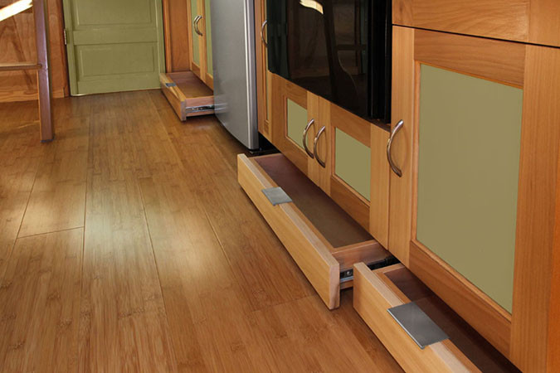

Slide 11
Client needs:
Main room-multipurpose
Kitchenette-no dishwasher
Eating area
Seating area
Bathroom
Closet area
Bedroom-queen bed

