Slide 1
Tiny House
Marcia Morrison

Slide 2
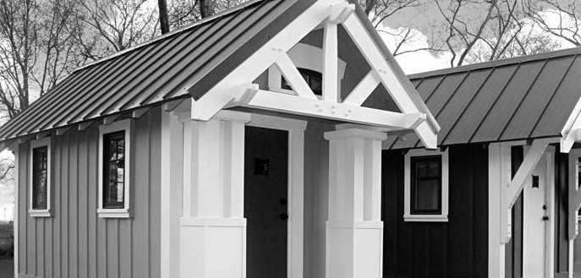
House layout
Loft area
Main floor

Slide 3
Design situation
Dimensions
Footprint: 19’x8’
Ceiling height: 6’
Loft Height: 3’-8”
Front porch-7.5’x 3’
3 windows on each side with one large on the end
Loft
Pitched roof

Slide 4
Design problems
Very small space
Want multipurpose areas
7 different areas
Lots of windows
Want to fit a queen bed in bedroom- 6’x 6’

Slide 5
Room Purpose
Main Room: Place where people relax and entertain
and entertain.
Kitchenette: Smaller version of a kitchen, used to prepare meals.
Eating Area: Place where people eat their meals.
Seating Area: Where people relax, read, watch tv
Closet Area: Use of storage for clothing and items.
Bathroom: Contains toilet, sink and shower.
Bedroom: Where people sleep

Slide 6
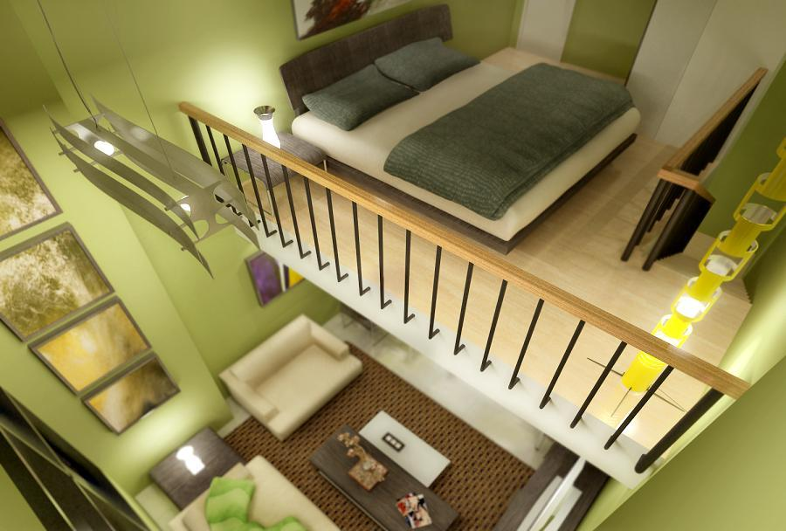
inspiration

Slide 7
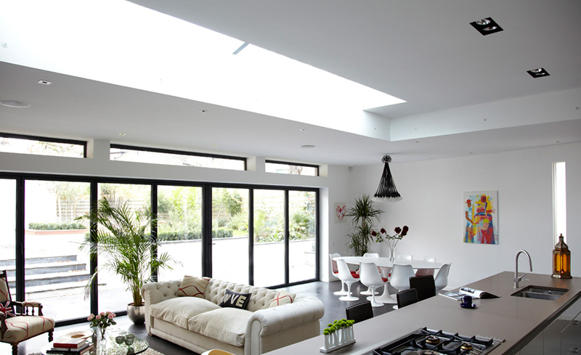
Multi-Use Spaces
Use open floor plans to allow spaces to be used for multiple functions.
If separate sections are needed, use furniture to separate them.

Slide 8
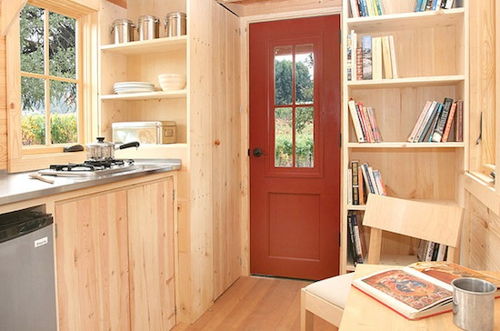
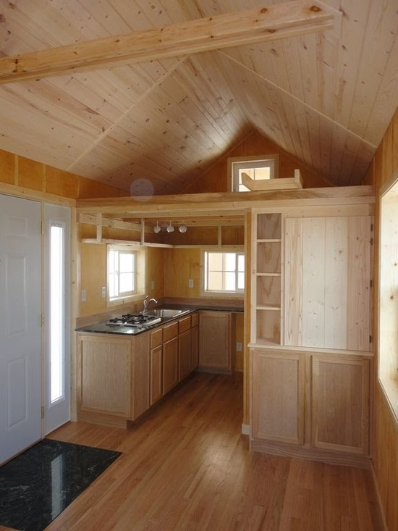
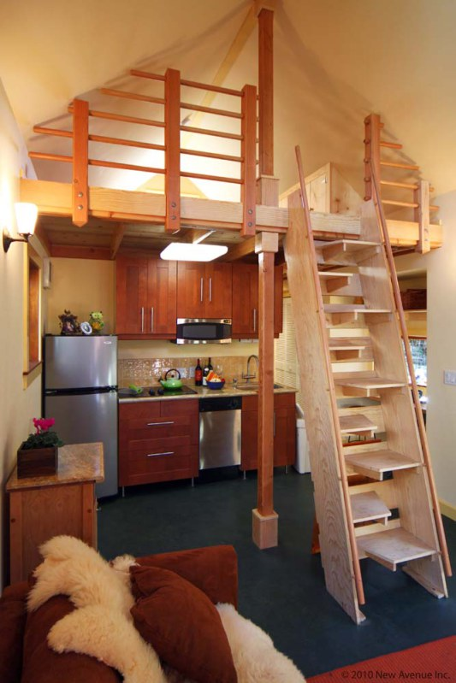
Architectural elements
Add shelving to large open walls
Use loft floor as extra storage for kitchen
Use of beams and columns to look larger

Slide 9
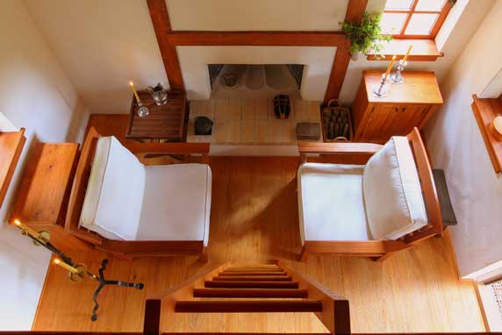
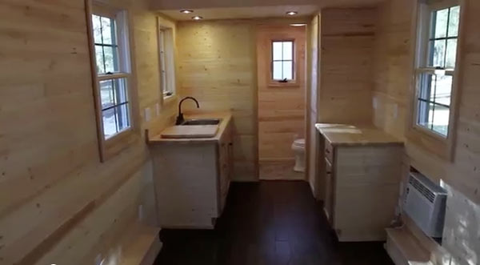
Non-architectural elements
Simple chairs for living room/ main room
Put kitchen near so that sink can work for both

