Slide 1
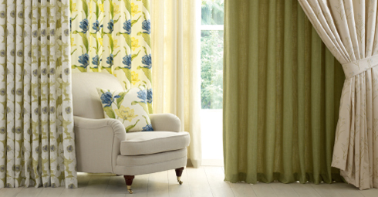
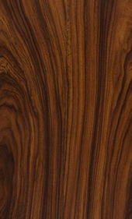
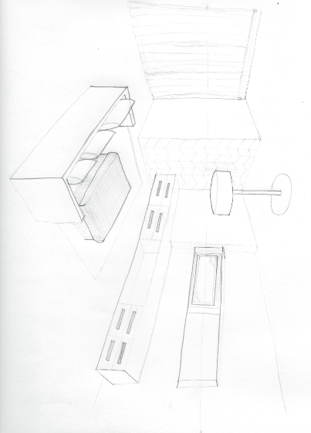
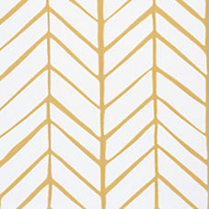
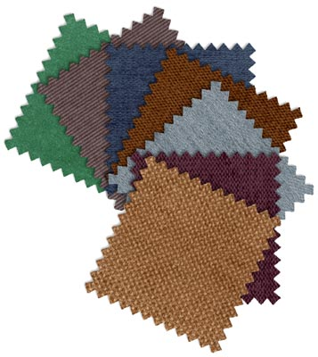
Pleated Curtain
Living Room Texture Perspective
Wood
Herringbone Wallpaper
Herringbone Wallpaper
Pleated Curtain
Fabric
Fabric
Wood

