Slide 1
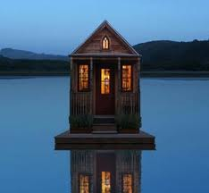
TINY HOUSE

Slide 2
Why do people like Tiny homes?
Can save money
Energy efficient
A secret getaway, place to relax
Space of your own (150 sq ft)
Can be portable (on wheels)
Can put them almost anywhere!

Slide 3
Versatility on architectural and non-architectural elements
They save space, open up the rooms
Save money $$
Keep things organized/ less cluttered
Makes good use of the area

Slide 4
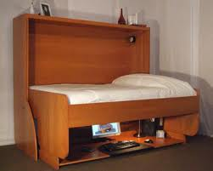
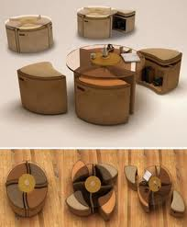
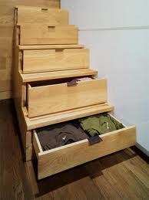
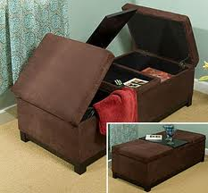
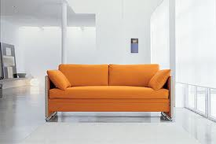
Versatility on architectural and non-architectural elements

Slide 5
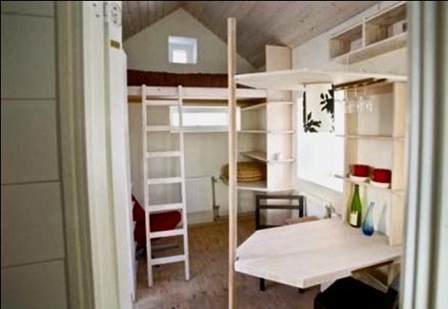
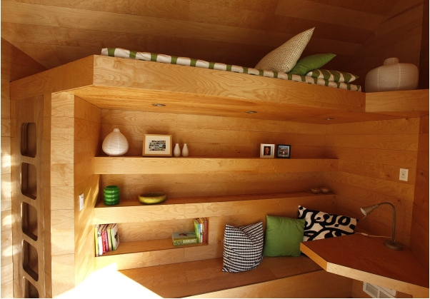
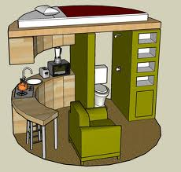
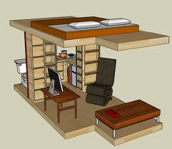
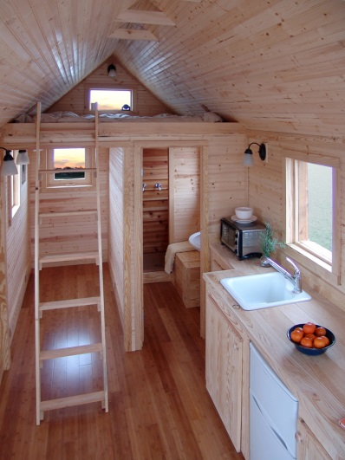
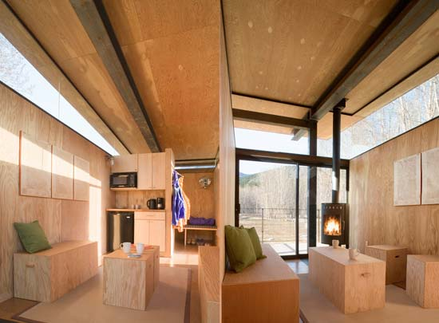
How to make a room into a multipurpose use space?

Slide 6
How non-architectural elements can be used in multipurpose way?
Refer to slide #2

Slide 7
What are these spaces? What are their functions?
Main room – place to relax, watch T.V.
Kitchenette – place to cook
Eating area – an area to enjoy your meals and socialize
Seating area – office area/place to read etc.
Bathroom – Good hygiene! ☺
Closet area - storage
Bedroom – place to relax and sleep

Slide 8
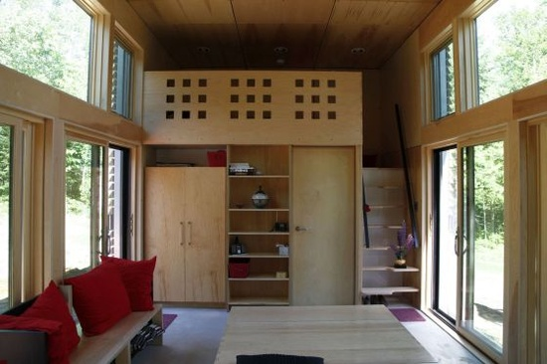
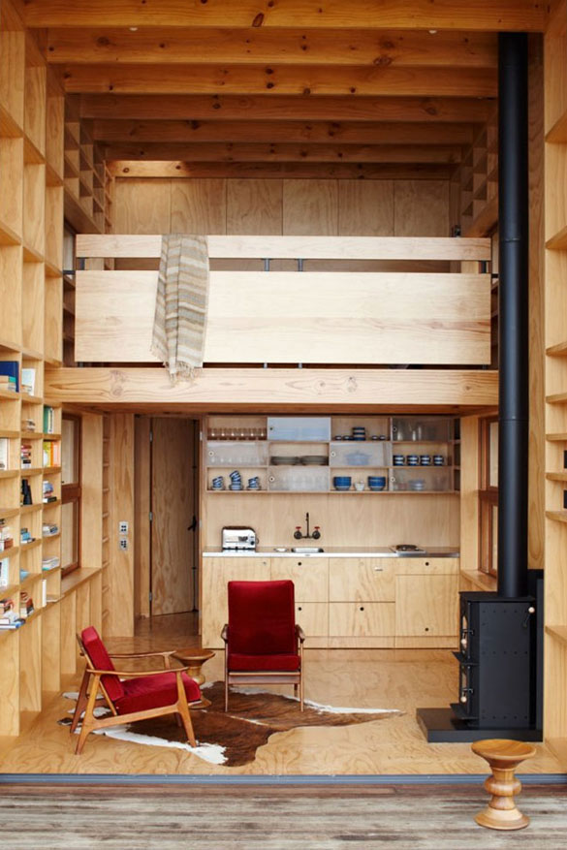
Main Room

Slide 9
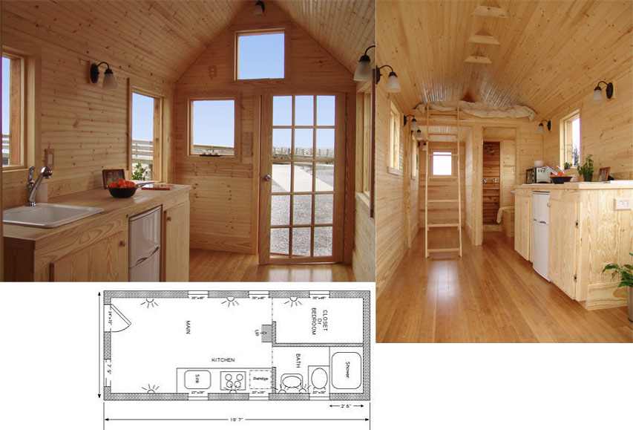
Kitchenette

Slide 10
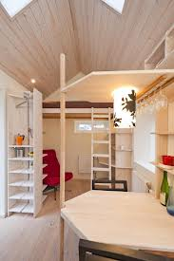
Eating Area

Slide 11
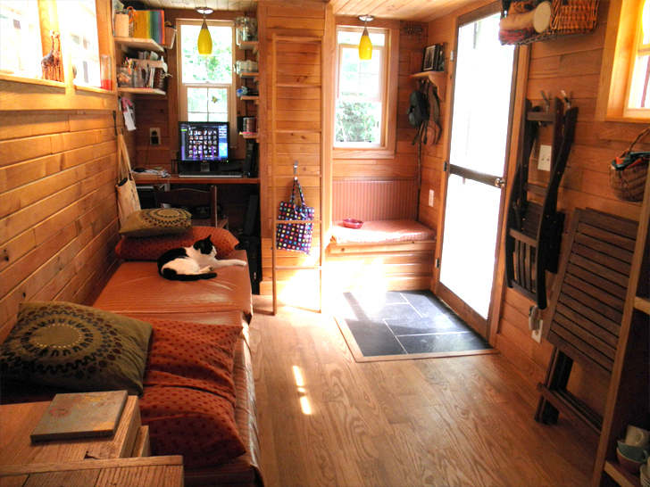
Seating Area

Slide 12
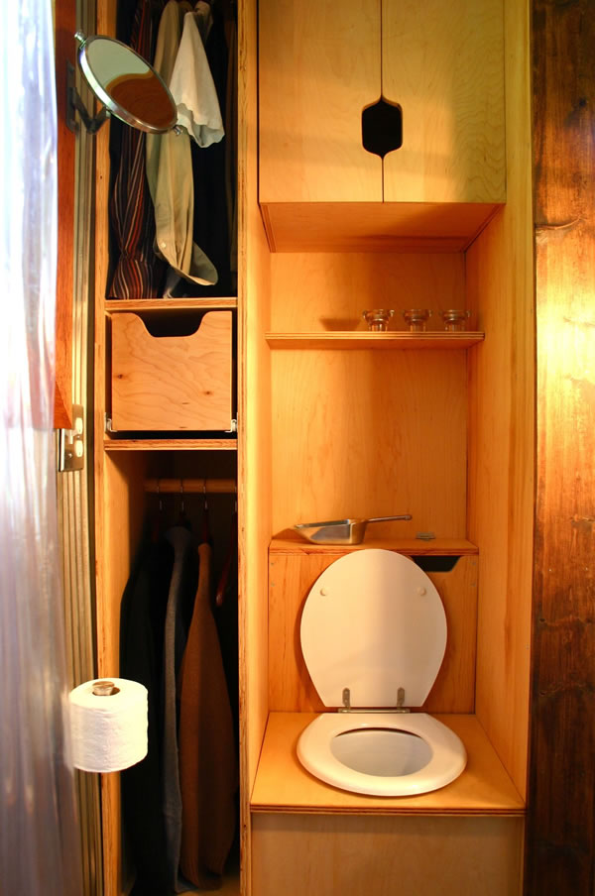
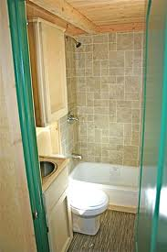
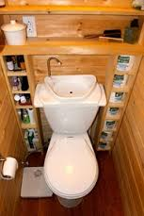
Bathroom

Slide 13
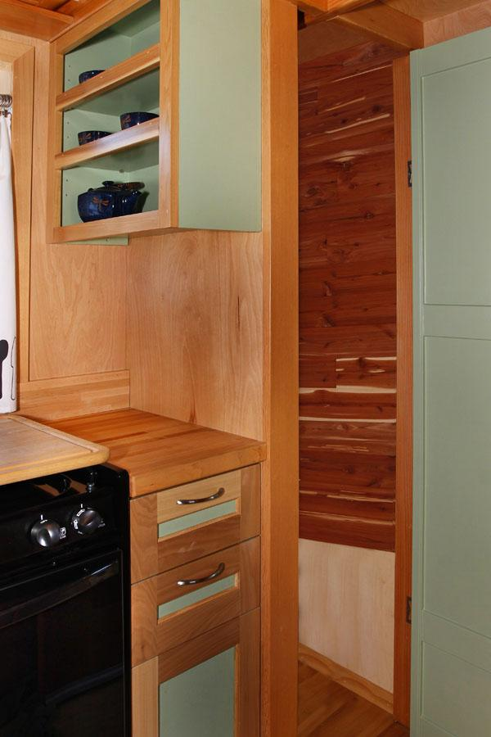
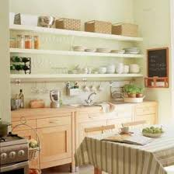
Closet/shelving

Slide 14
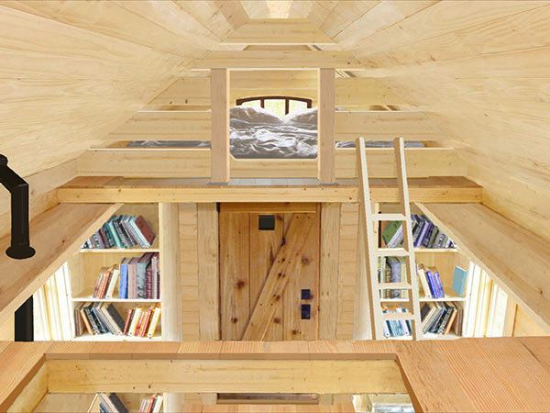
Bedroom

Slide 15
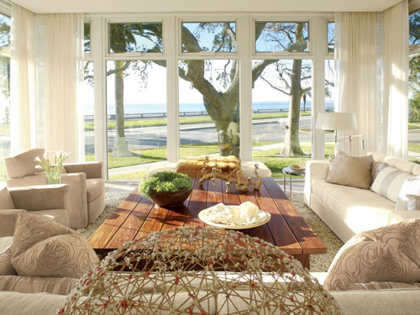
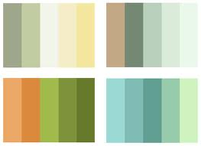
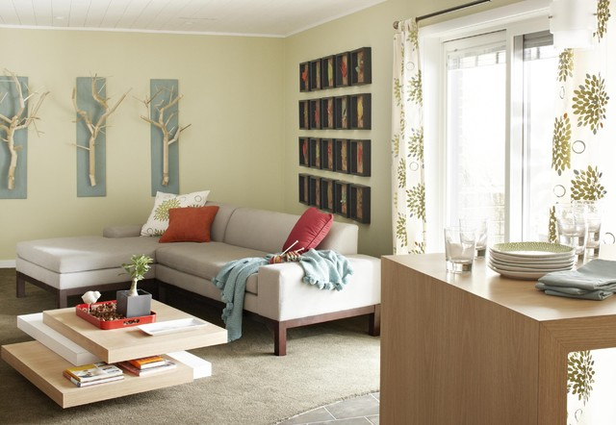
Natural, light, clean > since they like nature > Urban Chic

Slide 16
BY: Katie Kaywood ☺

