Slide 1
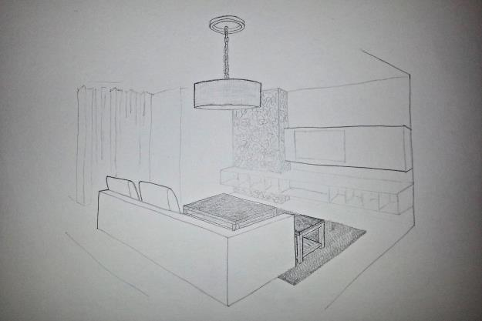
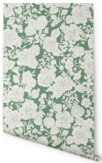
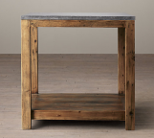
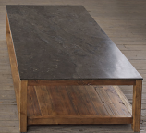
Chunky Braided Twist Rug in Charcoal (Restoration Hardware)
Garden Wallpaper in White/Mint (Karla Bruitt)
Living Room Perspective
with Texture Samples
Alexandra Ferrara
Bluestone Parsons Side Table (Restoration Hardware)
Bluestone Parsons Coffee Table (Restoration Hardware)

